Slide 1
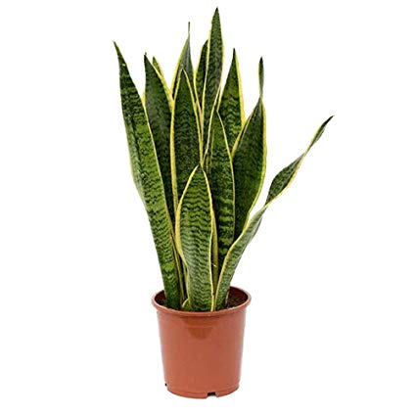
Plant Monitor
Chris Nelsen, Tomy Ogren, Bryn Caron
Problem Statement:
Create a system that will tell you if a plant needs water

Slide 2
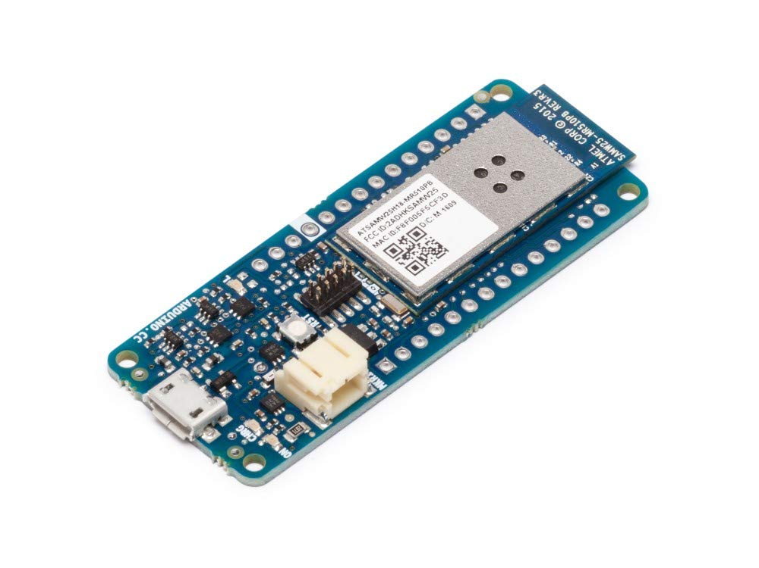
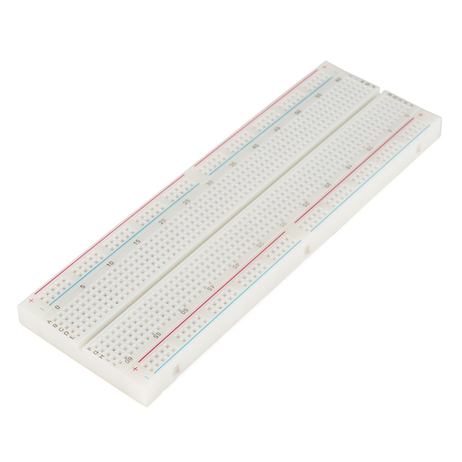
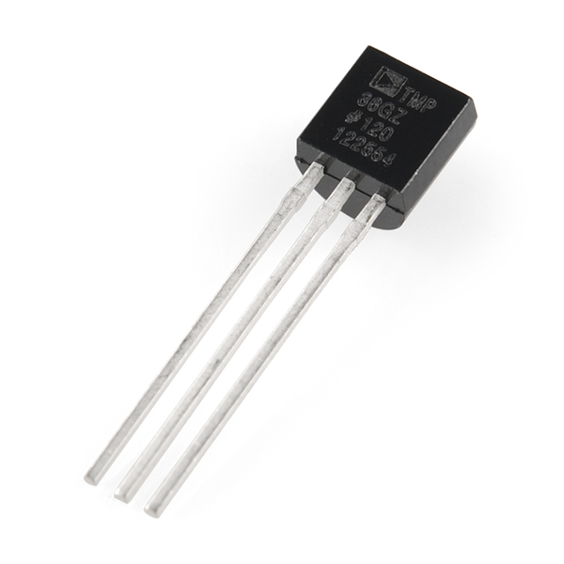

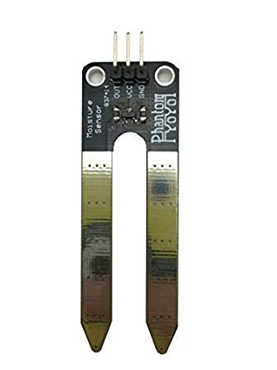
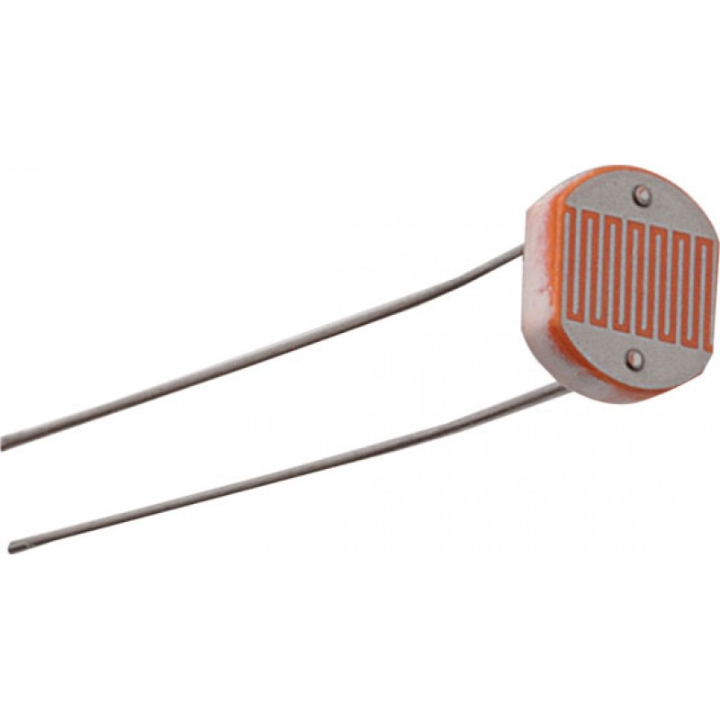
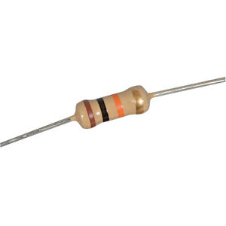
Original components
Arduino MKR1000
Breadboard
Temperature Sensor
Plant
Resistor 10K Ohm
Photoresistor
Moisture Sensor
Notes:
Chris

Slide 3
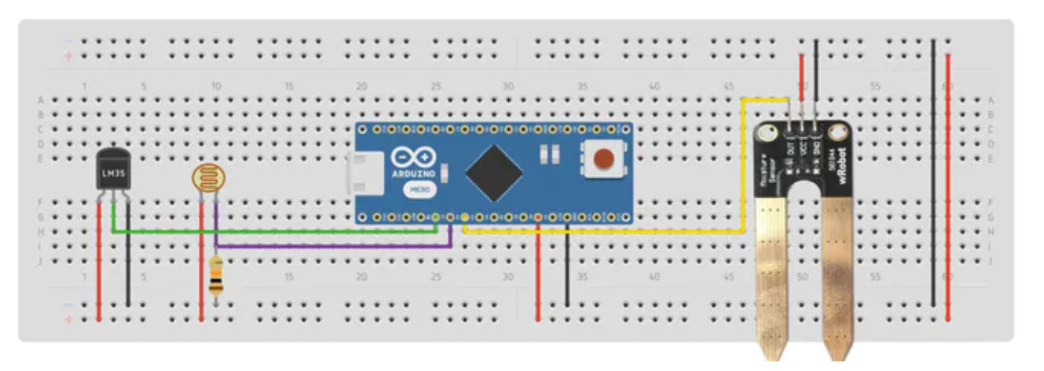
Original Setup
Photoresistor
Arduino MKR1000
LM35 Sensor
resistor
Moisture sensor
Notes:
Chris

Slide 4




The Four Steps
Construct and wire the board
Connect the wifi enabled MRK 1000 board to wifi
Download RethinkDB and set up localhost
Install Node and connect it to prewritten code
Notes:
Tomy

Slide 5
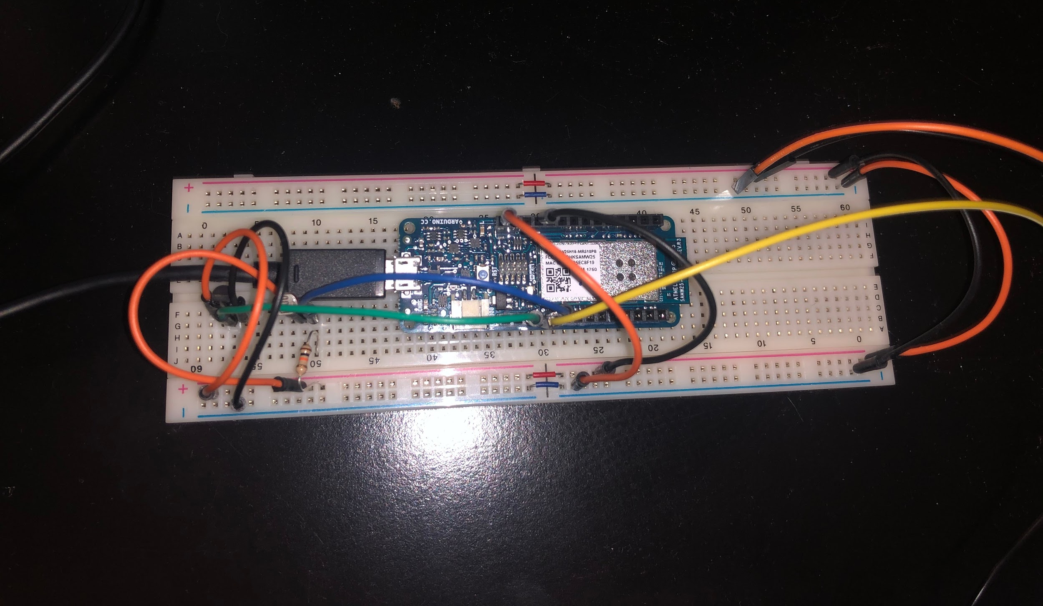
Trial and Error
The construction and wiring was completed.

Slide 6
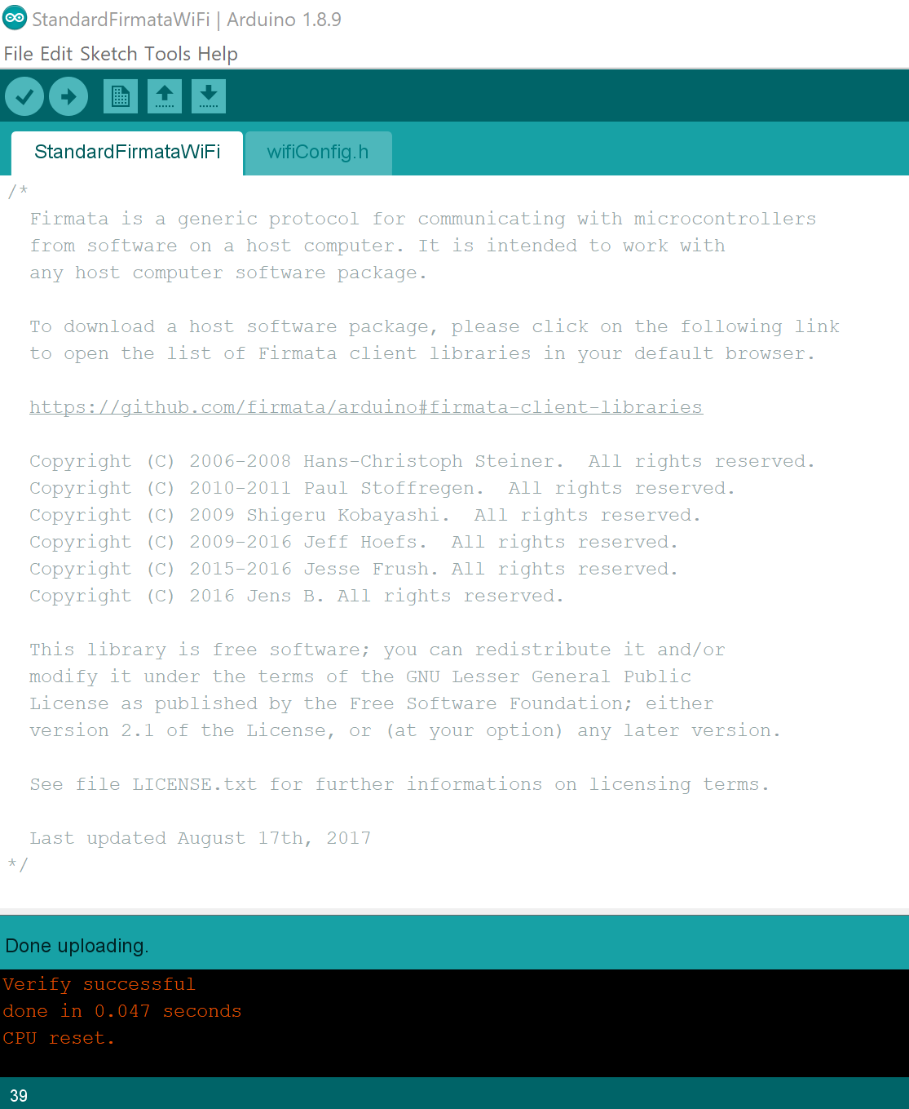
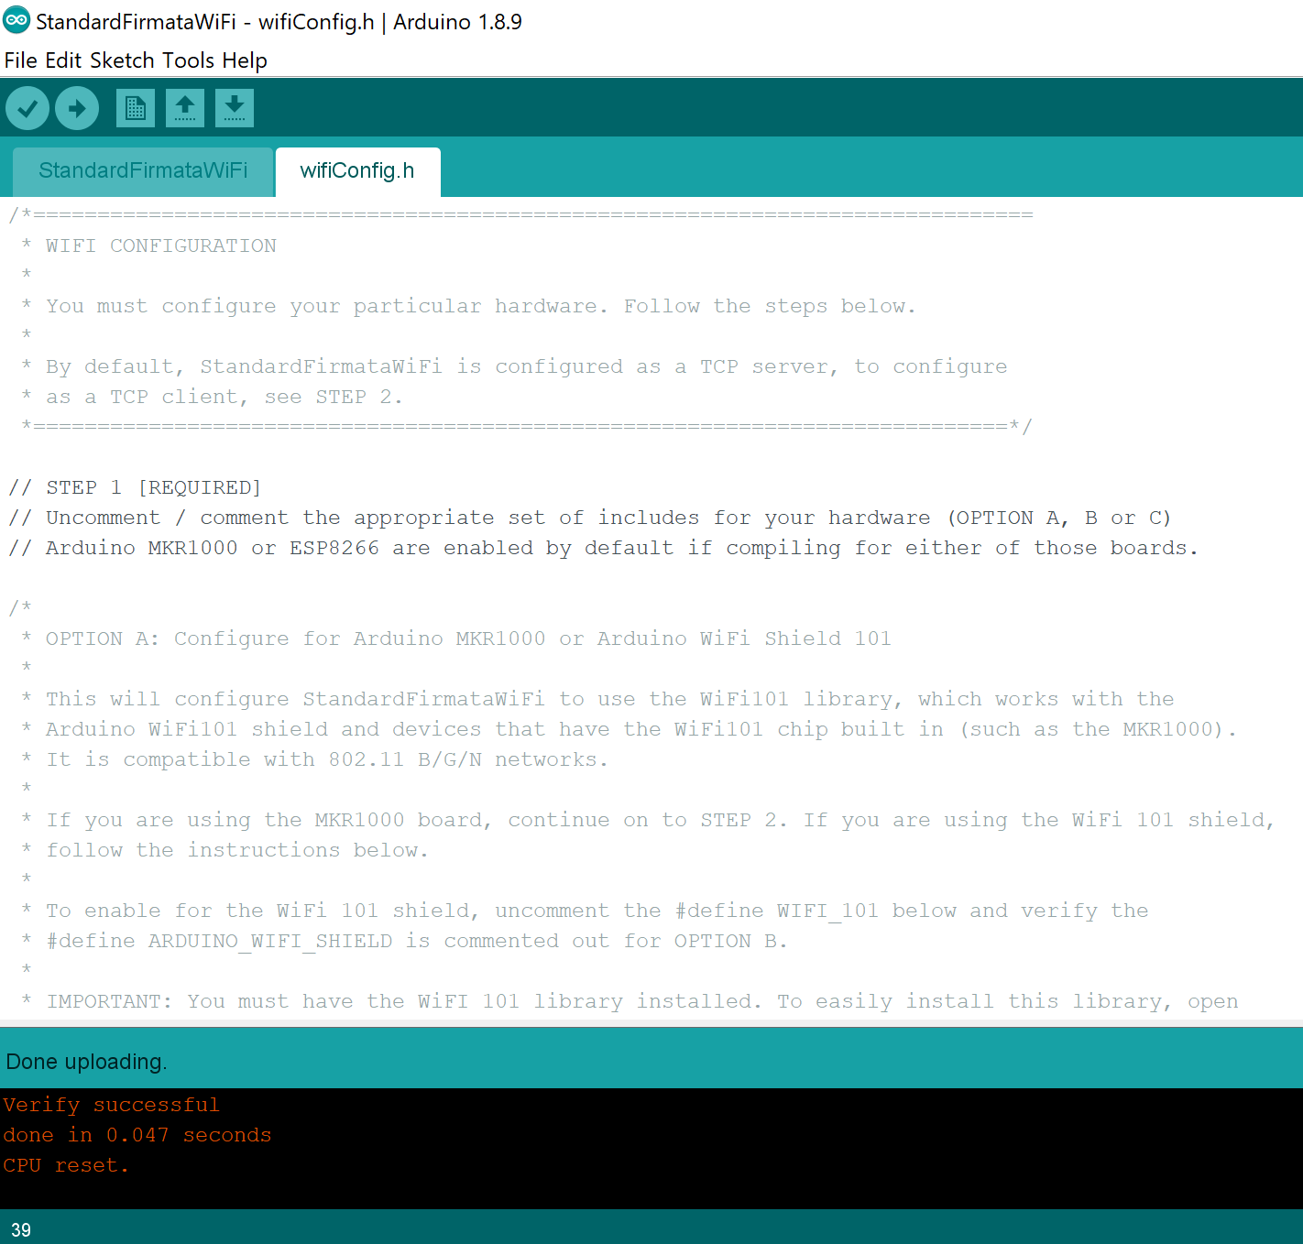
Trial and Error
Connecting the MRK 1000 to the internet went smoothly.
Notes:
Tomy

Slide 7
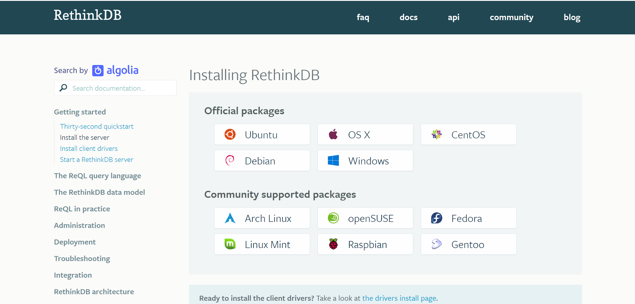
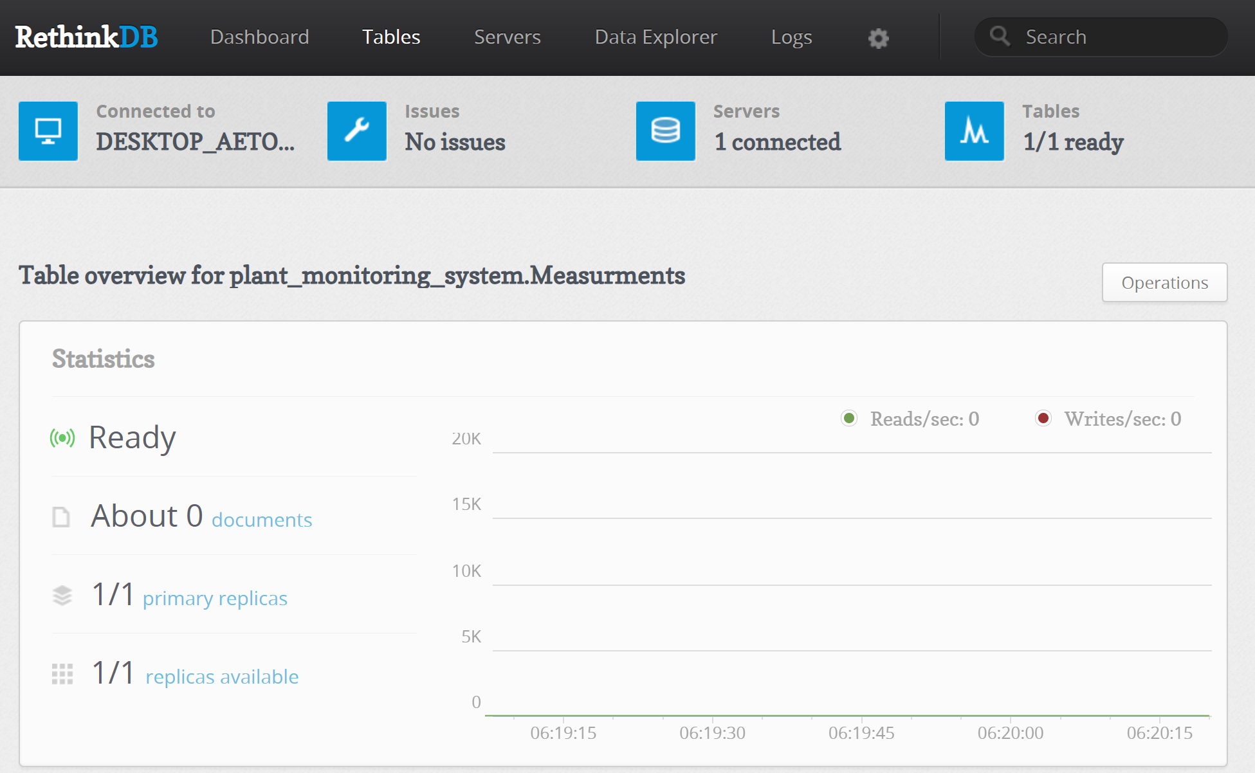
Trial and Error
Downloading and opening the localhost for the RethinkDB went well.
Notes:
Tomy

Slide 8
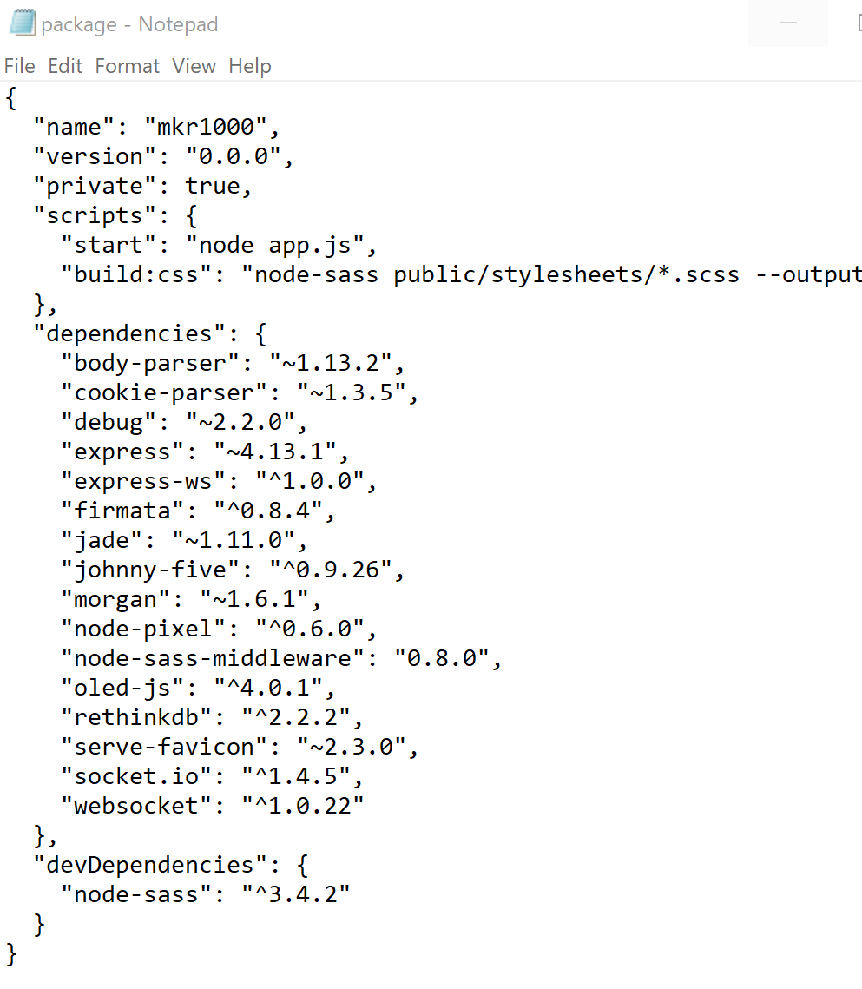


Trial and Error
Installing node went well.
However, installing node to the prewritten code we were going to use was a difficulty.
We realized the code was written 4 years ago so the dependencies were outdated.
Notes:
Tomy

Slide 9

The Solution
Realizing that it was going to take too long to fix we searched for another way to do it.
Which meant a whole new setup and components.
Notes:
Bryn

Slide 10
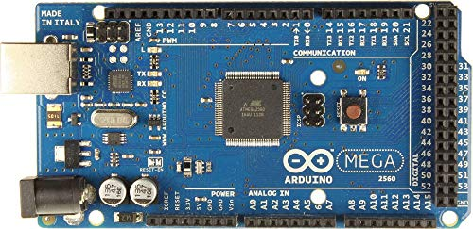
New components
Moisture Sensor
Arduino mega 2560
Plant
Notes:
Chris

Slide 11
Arduino mega 2560
New Setup
Moisture Sensor
Notes:
Chris

Slide 12
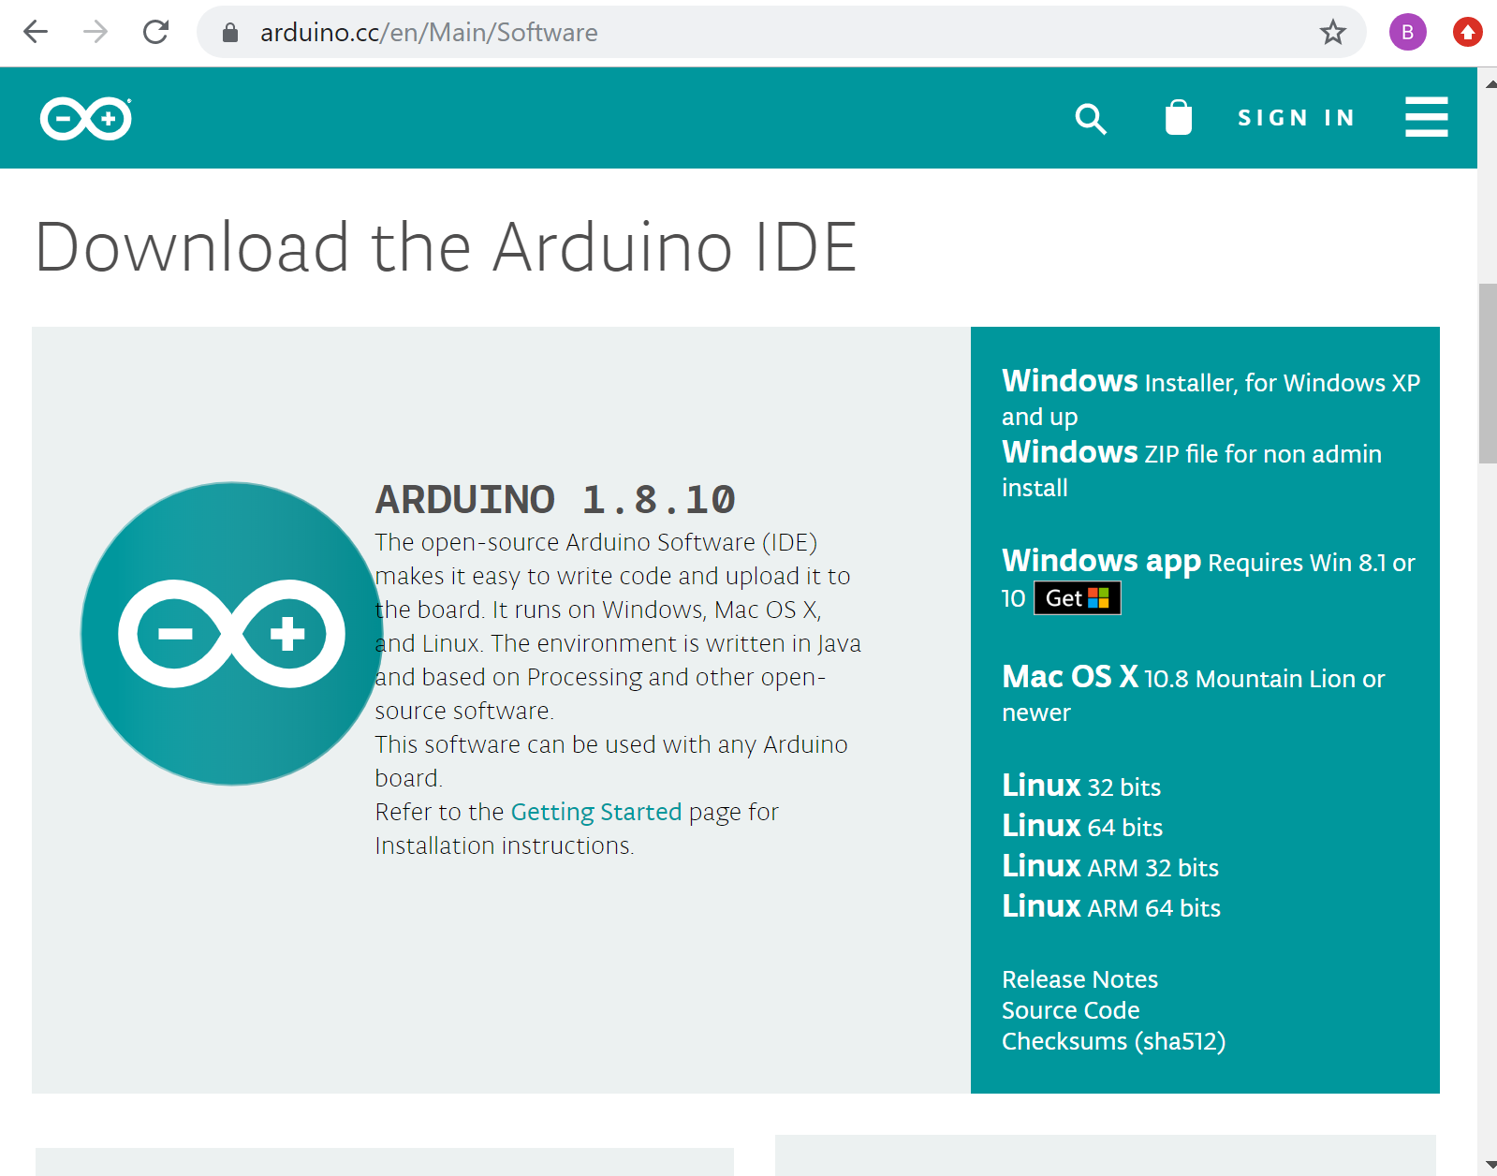
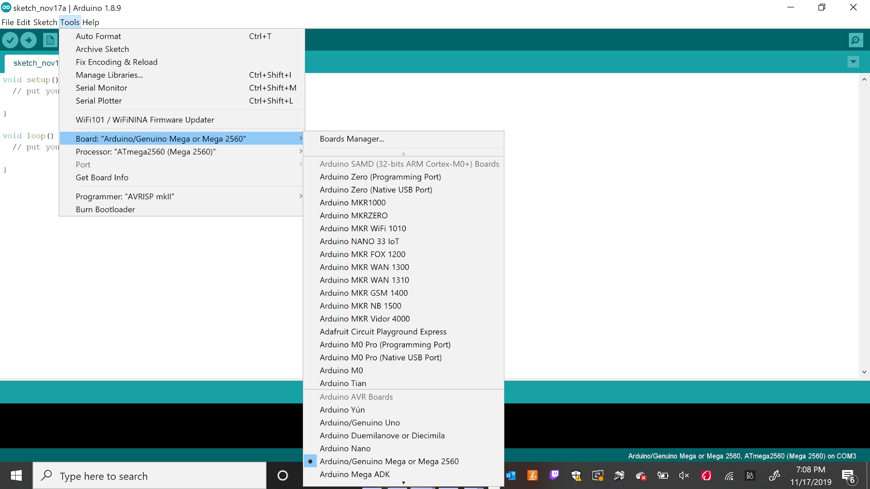
Modules and Packages
Arduino IDE
Installing Arduino IDE
Connecting to Arduino board
Notes:
Bryn

Slide 13
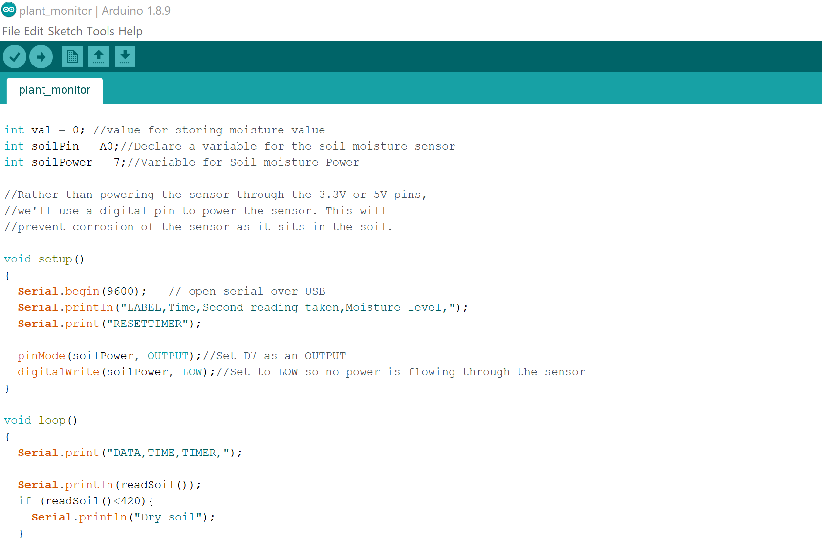
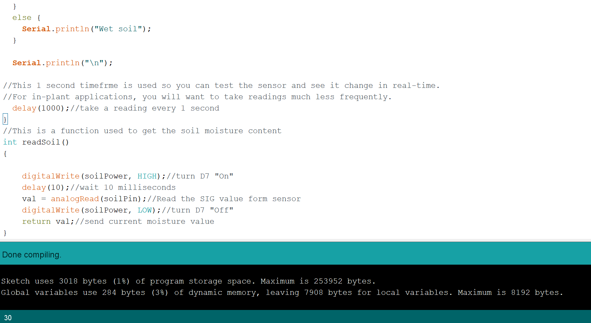
Modules and Packages
Arduino IDE
Uploading to the Arduino
Notes:
Bryn

Slide 14
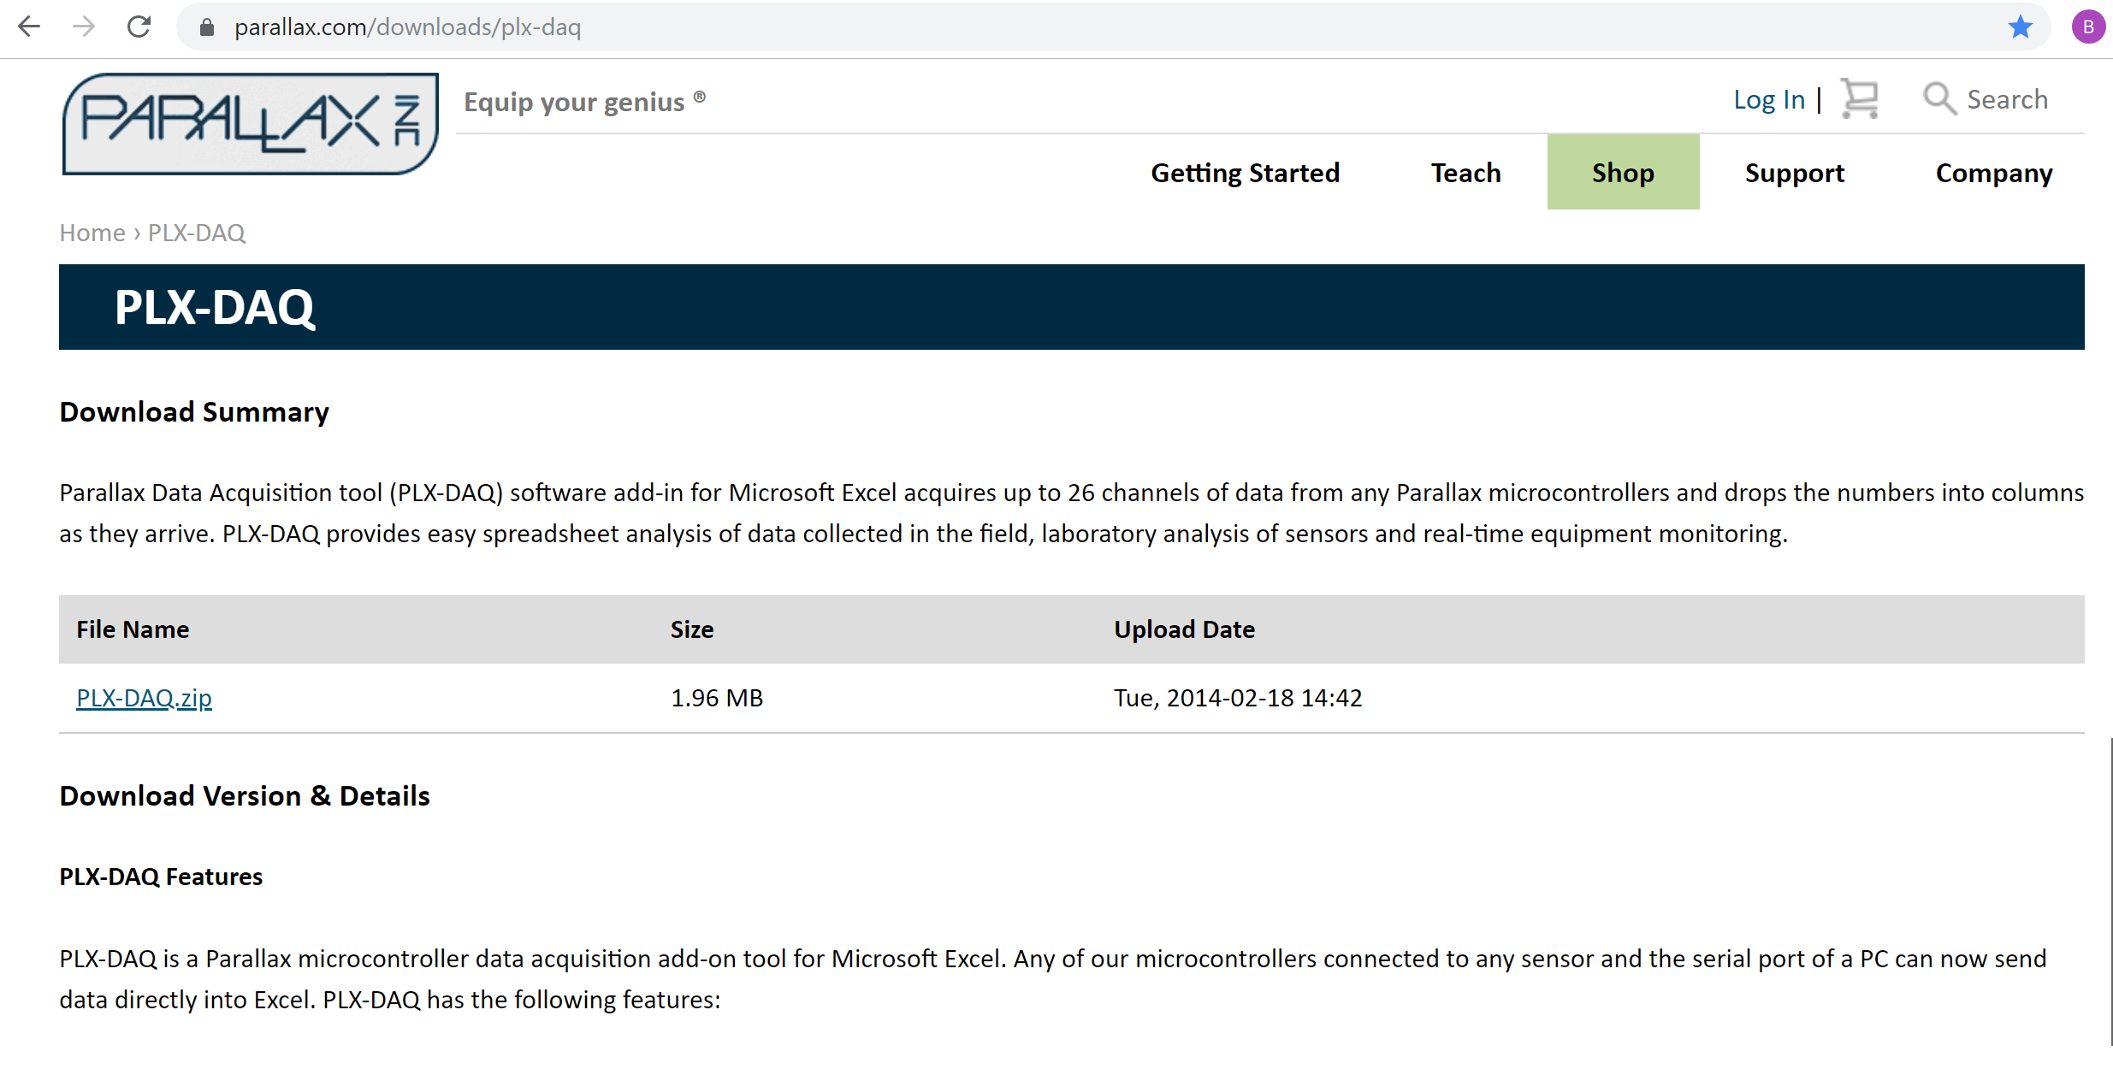

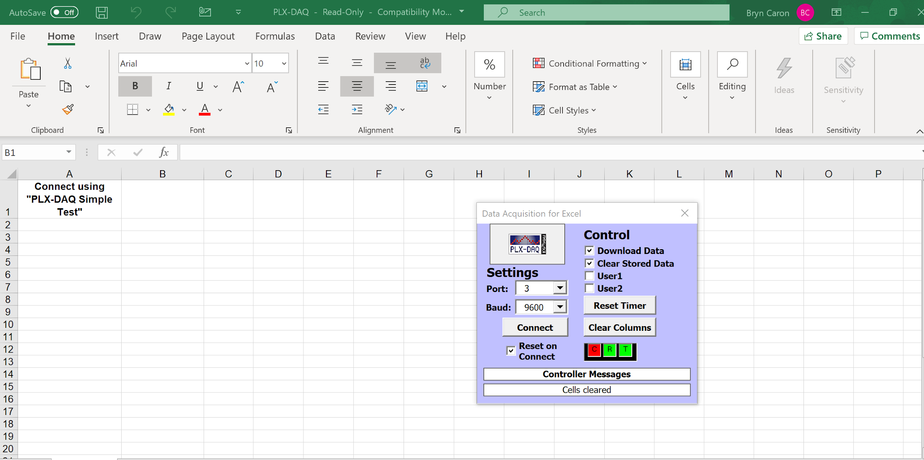
Modules and Packages
Excel VBA
Installation/setup
Notes:
Bryn

Slide 15
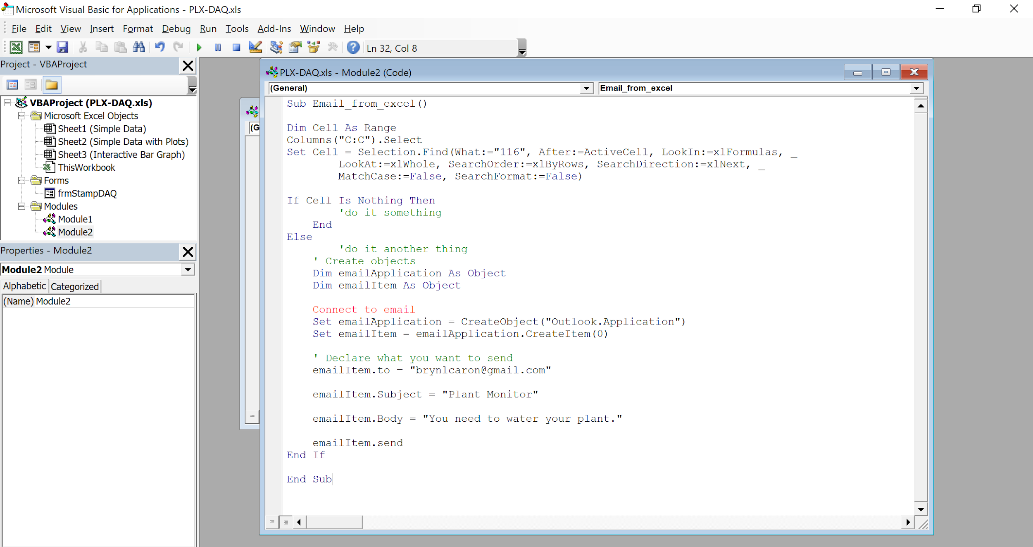
Modules and Packages
Excel VBA
Sending email notification code
Notes:
Bryn

Slide 16

Pros:
Cons:
Easier to store data over time (Excel)
Less components
Arduino mega 2560 has to be connected to a computer.
Arduino mega 2560 is not internet enabled.
Notes:
Chris

Slide 17
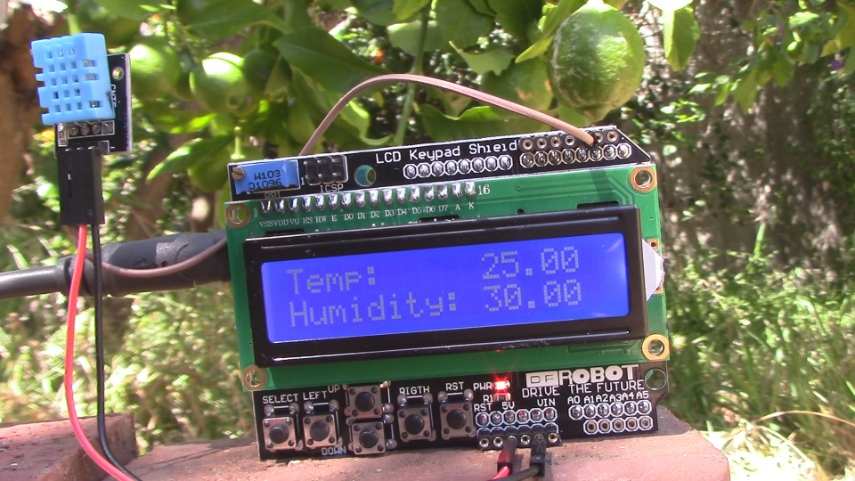
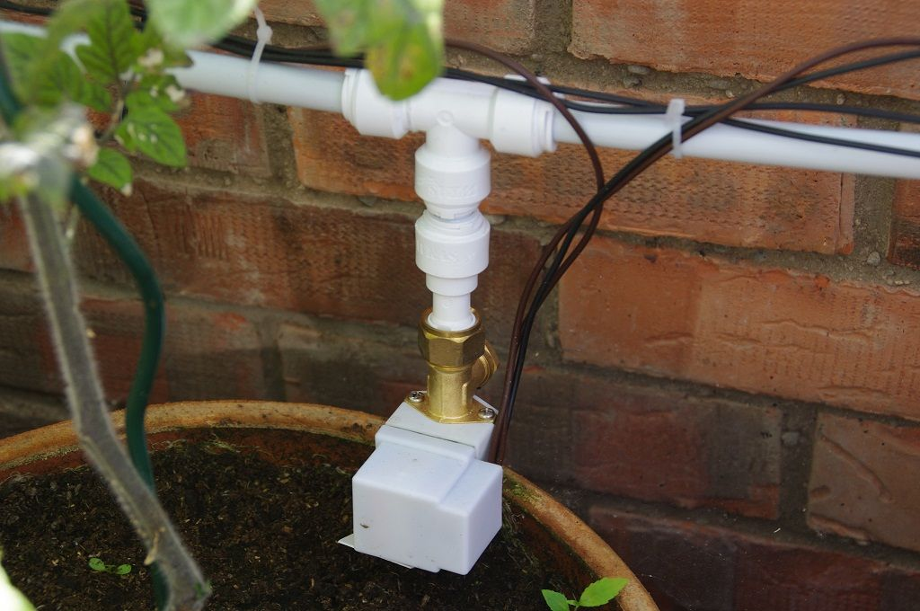
What we would do next
Install:
Better moisture sensors.
Temperature display.
Photosensor
Self watering system
Wireless
Notes:
Tomy

Slide 18
Sources
Software downloads:
https://www.arduino.cc/en/Main/Software
https://www.parallax.com/downloads/plx-daq
Code:
https://stackoverflow.com/questions/14931700/how-to-find-a-value-in-an-excel-column-by-vba-code-cells-find
https://www.instructables.com/id/Arduino-Soil-Moisture-Monitor/
Github:
https://github.com/Team-Grean-Thumbs/Plant-Monitoring-System
https://create.arduino.cc/projecthub/ryanjgill2/plant-monitoring-system-88ed2b?ref=tag&ref_id=garden&offset=0
https://www.instructables.com/id/Arduino-Soil-Moisture-Monitor/
https://www.instructables.com/id/Sending-data-from-Arduino-to-Excel-and-plotting-it/
https://www.youtube.com/watch?v=RPkbZ-rj2M0
https://www.youtube.com/watch?v=6Brrd8TnADk
https://uclalemur.com/blog/use-plx-daq-to-transform-data-between-arduino-and-excel
https://www.freecodecamp.org/news/how-to-create-read-update-and-search-through-excel-files-using-python-c70680d811d4/

